Slide 1


REVIEW OF RESEARCH PAPER
Post-cracking Behaviour of Steel Fibre Reinforced Concrete (2003)
- By J.A.O. Barros, V.M.C.F. Cunha, A.F. Ribeiro and J.A.B. Antunes
Published In:
Materials and Structures
NAME: M HEMA VARSHNI
YEAR & DEPT: 3rd Year Civil Engineering|
GUIDE NAME: Dr.Keerthana Kirupakaran

Slide 2
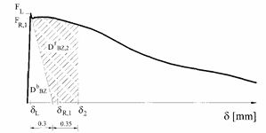
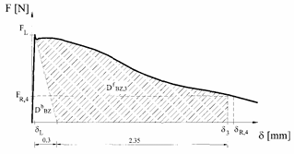
RILEM POST-CRACKING PARAMETERS
The paper explains the parameters proposed by RILEM TC 162-TDF for characterizing SFRC after cracking.
Equivalent Strength Parameters
feq,2
feq,3
These are calculated from the energy absorbed after cracking.
Residual Strength Parameters
fR,1
fR,4
These represent flexural stress at specified crack openings/deflections.
feq is based on energy absorption.
fR is based on individual points on the load-deflection curve.
fR may be more sensitive to local irregularities.
Fig 1. Evaluation ofJ;q,e andJ~,l flexural tensile strength
parameters according to RILEM TC 162-TDF [6, 8].
Fig 1. Evaluation Of feq,3 and fR,4 flexural tensile strength
parameters according to RILEM TC 162-TDF [6, 8].

Slide 3
EXPERIMENTAL PROGRAM
Experimental Procedure
Three-point bending test.
Notched beam specimens.
More than 200 tests conducted.
Different fibre contents investigated.
Fibre distribution on fracture surface evaluated.
Important Observation
Higher workability mixes showed fibre segregation during casting, affecting crack behaviour.
Materials
Two hooked-end steel fibres were used:
1. F80/60
Length = 60 mm
Diameter = 0.75 mm
Aspect ratio = 80
2. F65/60
Length = 60 mm
Diameter = 0.92 mm
Aspect ratio = 65
Objectives
Evaluate post-cracking behaviour.
Study influence of:
  Fibre content
  Fibre type
  Fibre distribution

Slide 4
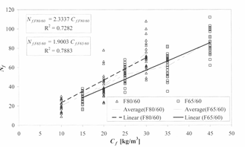
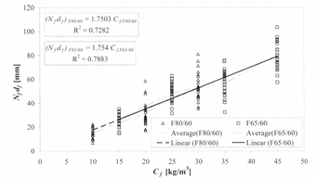
FIBRE DISTRIBUTION RESULTS
The fracture surfaces were examined to determine fibre distribution.
Findings
Number of fibres crossing the fracture surface increased with fibre content.
F80/60 specimens contained more fibres due to smaller diameter.
Fibre segregation occurred in casting direction.
Fibre distribution strongly influences post-cracking behaviour.
Fibre Reinforcement Index
The authors defined:
Nf × df
where:
Nf = number of fibres crossing fracture surface
df = fibre diameter
This index better represents reinforcement effectiveness.
Fig 3. Relationship between the content of fibres, Cf; and the number of fibres on the specimen fracture surface, Nf.
Fig 4. Relationship between the content of fibres, Cf; and the
fibre reinforcement index, Nfdf.

Slide 5
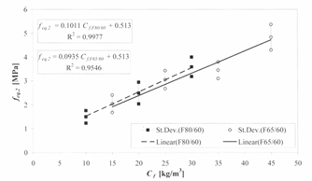
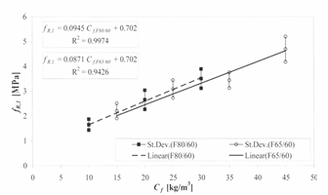
INFLUENCE OF FIBRE CONTENT ON POST-CRACKING STRENGTH
The paper shows that increasing fibre dosage improves post-cracking performance.
Observations
Equivalent Strength
feq,2 increases almost linearly with fibre content.
Residual Strength
fR,1 also increases with fibre content.
Comparison
F80/60 generally produced slightly higher values.
Behaviour depends on actual number of fibres crossing the crack plane.
Fig 5. - Relationship between Cf and feq.2.
Fig 6. - Relationship between Cf and fe.1.

Slide 6
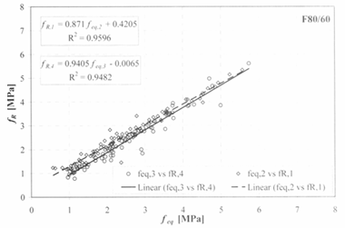
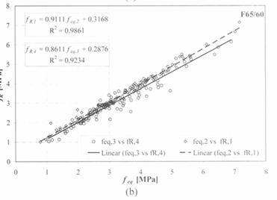
RELATIONSHIP BETWEEN FEQ AND FR
One major objective was to determine whether residual strength parameters could replace equivalent strength parameters.
Findings
Strong correlation exists between feq and fR.
Both parameters describe post-cracking behaviour effectively.
However:
Important Conclusion
fR showed larger scatter.
This occurs because:
fR depends on specific points on the load-deflection curve.
feq is based on absorbed energy and is more stable.
feq is more suitable for design purposes.
Fig 7. Correlation between fq and fk in series reinforced with
fibres (a) F80/60 and (b) F65/60.

Slide 7
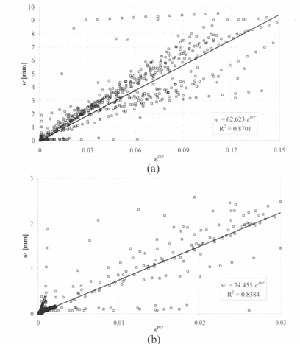
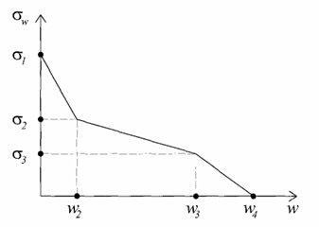
NUMERICAL MODELLING AND CONCLUSIONS
Final Conclusions
Both feq and fR increase with fibre content.
Strong correlation exists between feq and fR.
feq shows lower scatter and is more reliable.
Numerical inverse analysis successfully reproduced experimental load-deflection curves.
Fracture process zone length ranged from approximately 62.5–75 mm.
Numerical Model
A layered cross-section model was developed.
Two constitutive approaches were studied:
1. σ – ε Method
Stress–strain relationship
2. σ – w Method
Stress–crack opening relationship
Findings
Original RILEM σ–ε model did not accurately reproduce experimental behaviour.
Inverse analysis provided improved constitutive parameters.
Relationship between crack opening and post-cracking strain was established.
Fig 8. Stress crack opening diagram used in the a-w-method.
Fig 9. Relationship between the post cracking strain, Epcr, and the crack opening displacement, w, for a crack opening up to a) 10 mm and b) 3 mm.

